Slide 1
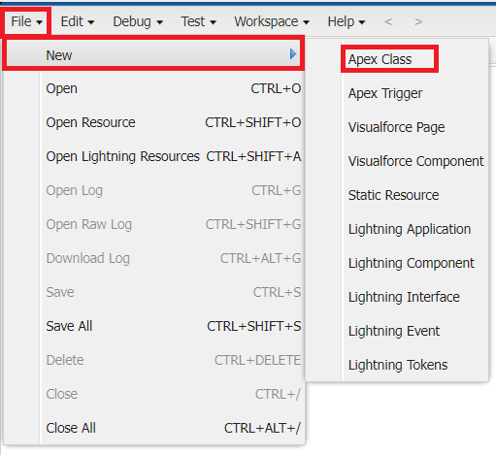
Create Batch Apex

Slide 2
Source Code:
global class InventoryBatchJob implements Database.Batchable<SObject>, Schedulable {
global Database.QueryLocator start(Database.BatchableContext BC) {
return Database.getQueryLocator(
'SELECT Id, Stock_Quantity__c FROM Product__c WHERE Stock_Quantity__c < 10'
);
}
global void execute(Database.BatchableContext BC, List<SObject> records) {
List<HandsMen_Product__c> productsToUpdate = new List<HandsMen_Product__c>();
// Cast SObject list to Product__c list
for (SObject record : records) {
HandsMen_Product__c product = (HandsMen_Product__c) record;
product.Stock_Quantity__c += 50; // Restock logic
productsToUpdate.add(product);
}
if (!productsToUpdate.isEmpty()) {
try {
update productsToUpdate;
} catch (DmlException e) {
System.debug('Error updating inventory: ' + e.getMessage());
}
}
}

Slide 3
global void finish(Database.BatchableContext BC) {
System.debug('Inventory Sync Completed');
}
// Scheduler Method
global void execute(SchedulableContext SC) {
InventoryBatchJob batchJob = new InventoryBatchJob();
Database.executeBatch(batchJob, 200);
}
}
Save the code.(click on file → Save)

Slide 4
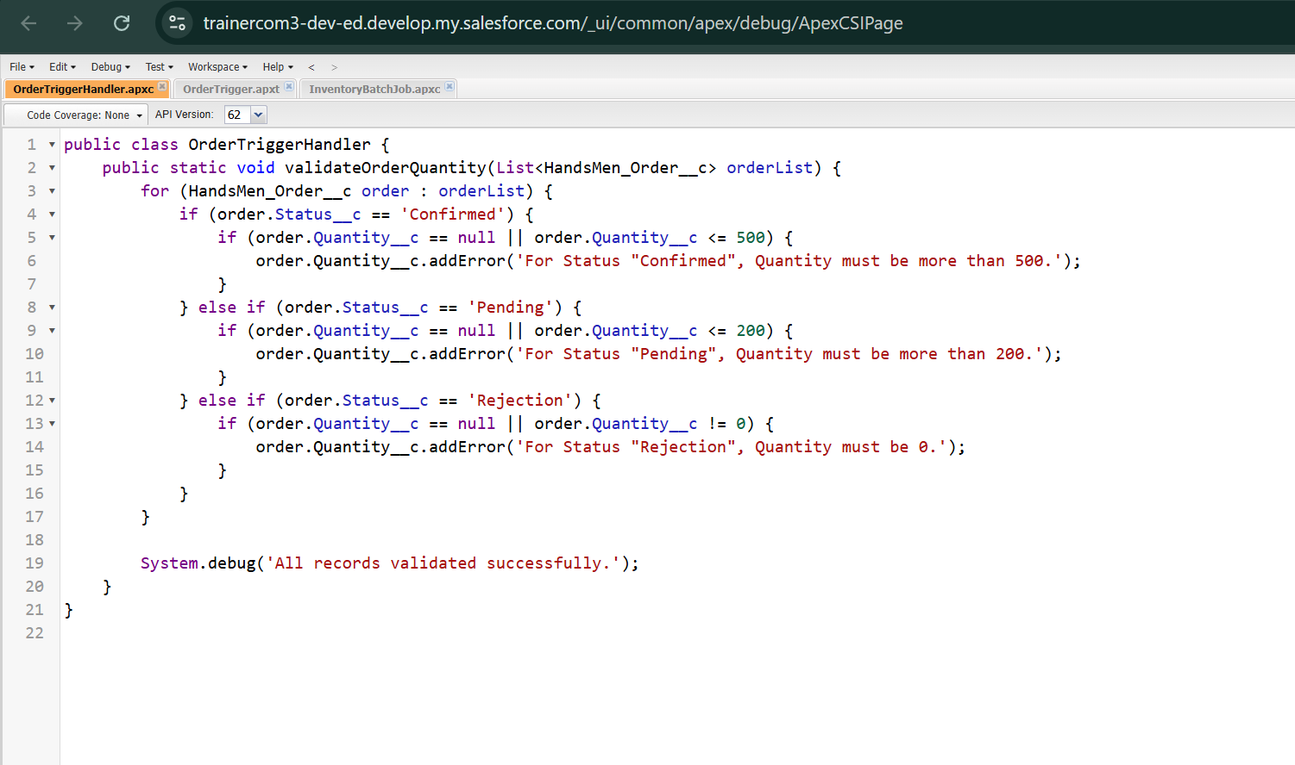

Slide 5
Source Code:
public class OrderTriggerHandler {
public static void validateOrderQuantity(List<HandsMen_Order__c> orderList) {
for (HandsMen_Order__c order : orderList) {
if (order.Status__c == 'Confirmed') {
if (order.Quantity__c == null || order.Quantity__c <= 500) {
order.Quantity__c.addError('For Status "Confirmed", Quantity must be more than 500.');
}
} else if (order.Status__c == 'Pending') {
if (order.Quantity__c == null || order.Quantity__c <= 200) {
order.Quantity__c.addError('For Status "Pending", Quantity must be more than 200.');
}
} else if (order.Status__c == 'Rejection') {
if (order.Quantity__c == null || order.Quantity__c != 0) {
order.Quantity__c.addError('For Status "Rejection", Quantity must be 0.');
}
}
}
System.debug('All records validated successfully.');
}
}

